Slide 1

17. Vessel wall to lumen ratio determination in adaptive optics retinal images
TEAM PROJECT MPA-ABO
Autors: Vasilii Fedorov, Klára Sakmárová, Adriána Špaková

Slide 2
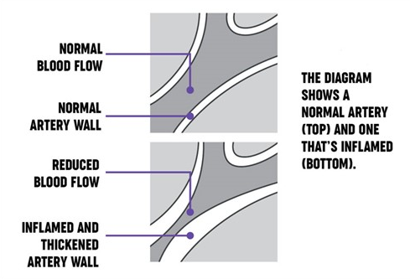
What reveals the vessel wall to lumen ratio ?

Slide 3
The main aim
Design and realize automatic algorithm for vessel wall segmentation.
Determine the vessel wall to lumen ratio.
Test the proposed algorithm and evaluate the obtained results.

Slide 4
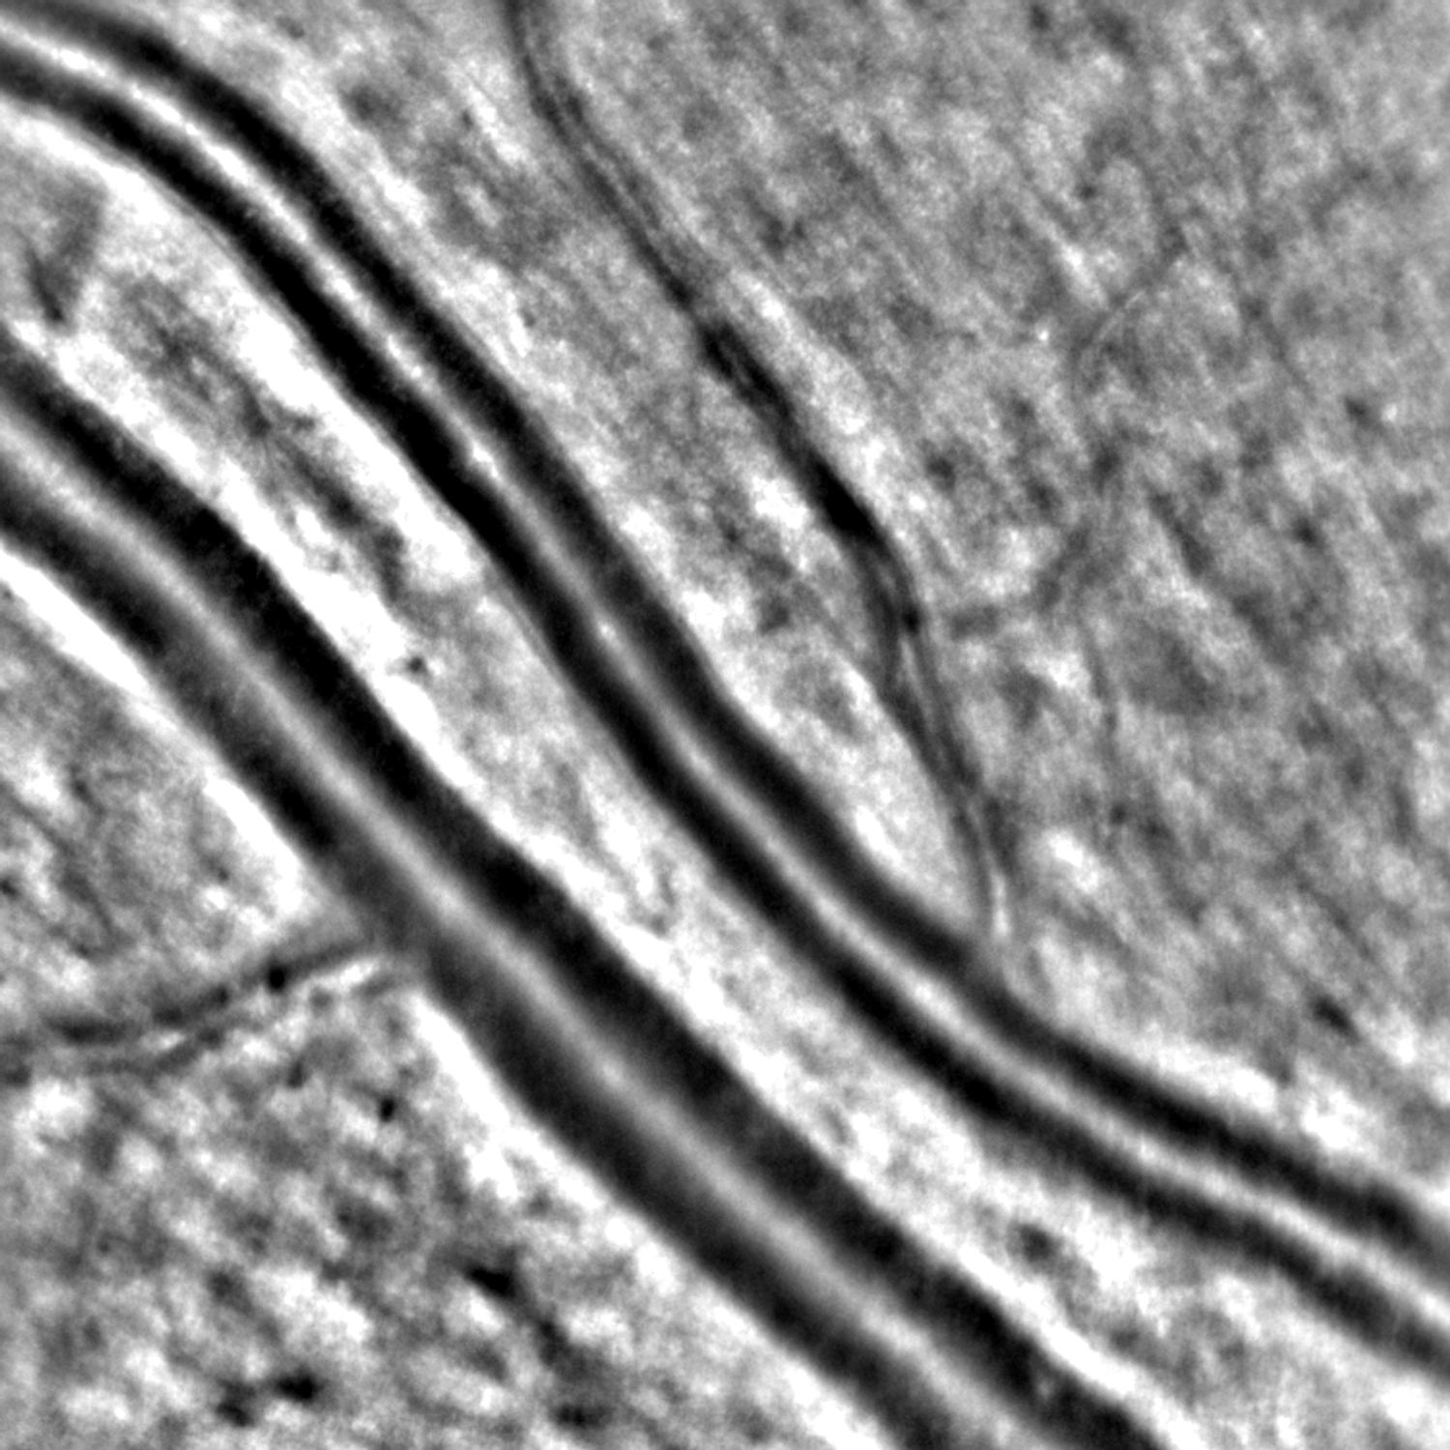
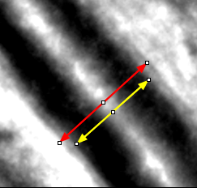
Input data
Database includes grayscale images 1500x1500 [px], gained by Adaptive Optics (AO)

Slide 5
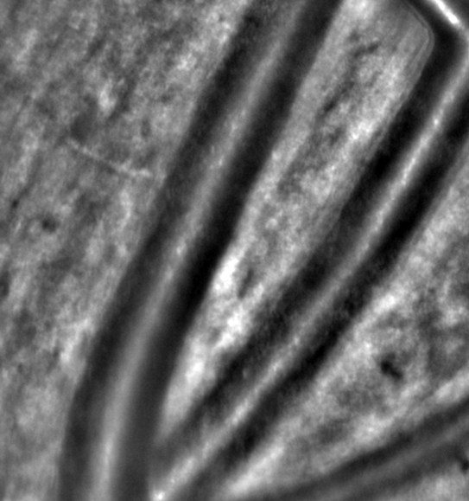
Input data
What about this one ?
Can you see the vessel wall clearly ?

Slide 6
Input data
What about this one ?
Can you see the vessel wall clearly ?
Data preprocessing
Vessel center segmentation
WLR calculation
??????

Slide 7
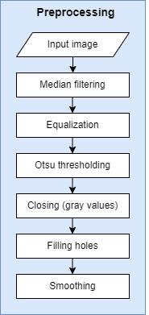
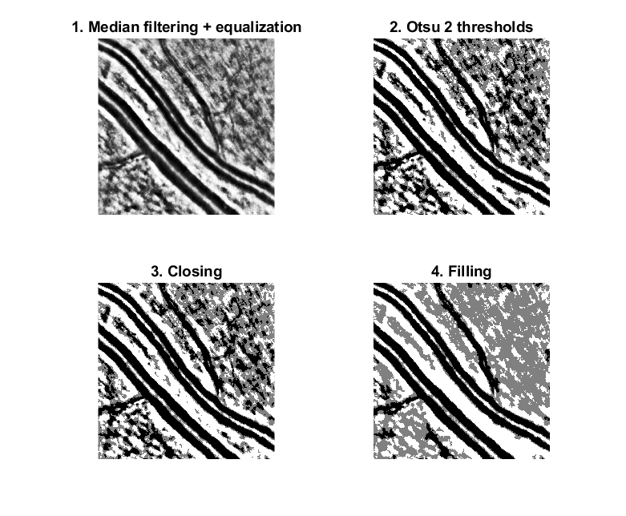
1. Data preprocessing
Preprocessing of image no. 1
Preprocessing diagram

Slide 8
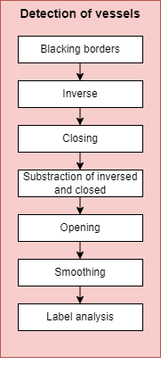
2. Vessel center segmentation
Vessel center segmentation of image no. 1
Detection of vessel diagram

Slide 9
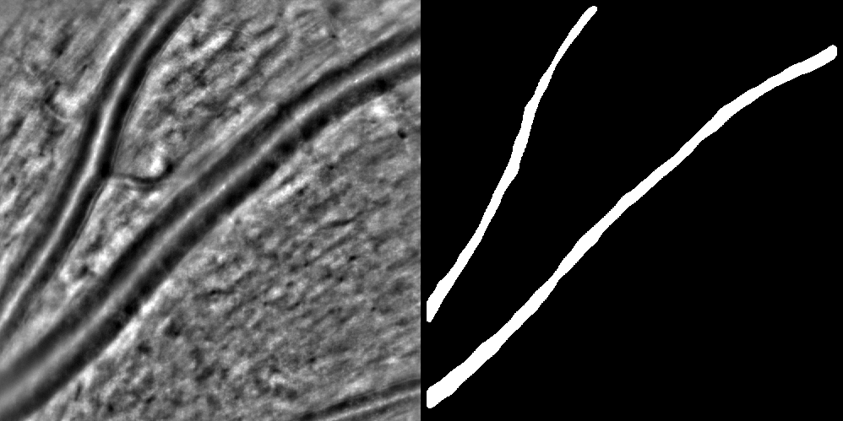
2. Vessel center segmentation, examples:

Slide 10
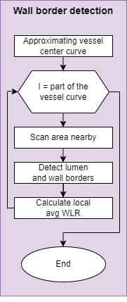
3. WLR Calculation
Approximating vessel center curve:
Separate labeled object into several objects in direction of higher std
Calculate centroids of final objects
Approximate curve by Nearest Neighbor joining from the furthest centroid
Approximating vessel center curve
WLR calculation diagram

Slide 11
3. WLR Calculation
Centroids of separated line parts
Curve through centroids

Slide 12
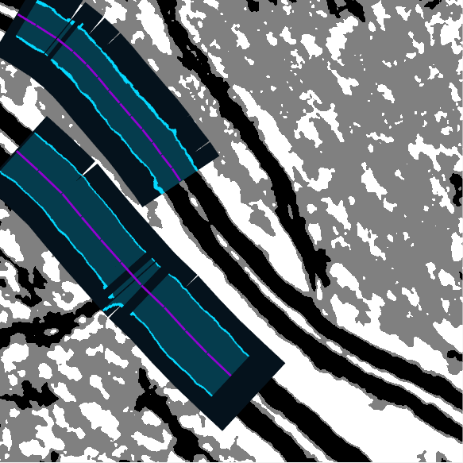
3. WLR Calculation
wall
lumen
Process of scanning lines
and border detection
Scanning lines perpendicular
to the center curve

Slide 13
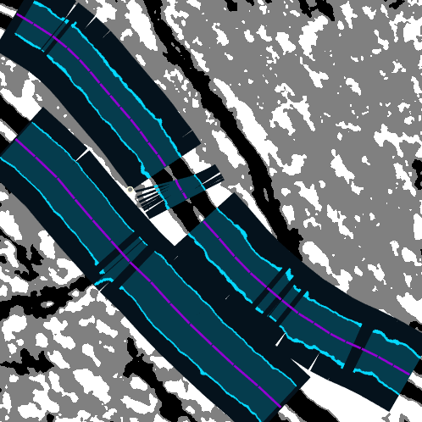
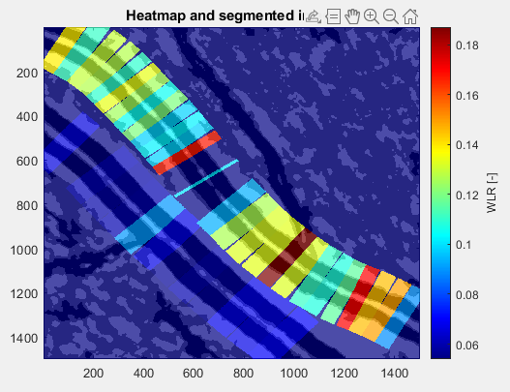
3. WLR Calculation
wall
lumen
Scanning area and detecting borders
Heatmap on the image

Slide 14
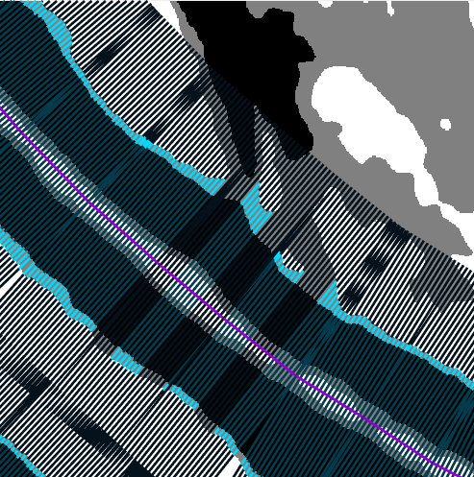
3. WLR Calculation
wall
lumen
Zoomed part with scanning lines and detected walls

Slide 15
Thank you for your attention
xfedor09@vutbr.cz
xspako00@vutbr.cz
xsakma00@vutbr.cz

